Slide 1
Review of Mendelian Genetics
PLS 664 Spring 2011

Slide 2
Environmental vs Heritable Sources of Variation
Environmental Sources
Soil, temperature, light: reflected in vigor
Photoperiod: plant may or may not flower
Seed size: smaller seedlings from smaller seeds than from larger, but they are genetically identical
Yield of two plants from the same variety will vary if one is infected with rust, the other not
Because these variations are environmental in nature they cannot be transmitted to progeny

Slide 3
Environmental vs Heritable Sources of Variation
Heritable Sources
Easily observed: color, amt of pubescence on leaves, awns vs awnless
These characteristics (traits) are reproducible in the progeny
Complex: vigor, disease resistance, plant height, plant yield
Progeny of these plants may express these traits to a greater or lesser extent than the parents

Slide 4
Environmental vs Heritable Sources of Variation
Interaction of heritable and environmental sources of variation
Wheat plant that is genetically resistant to leaf rust requires the presence of the pathogen (environment) to exhibit the trait
Winter hardy oat requires the right environment (cold stress) to demonstrate presence of the trait

Slide 5
Heritable Variation
Heritable variation is essential to the plant breeder; without it, there could be no progress from plant breeding
What is the breeder looking for?
Qualitative traits: discrete, simply inherited
Quantitative traits: continuous, complex inheritance

Slide 6
Plant Breeders vs Geneticists
Plant breeders focus on traits of economic importance and how these traits can be combined in a superior variety
Geneticists focus on understanding and illuminating the mechanisms by which traits are inherited and further, the molecular underpinnings of these traits and/or genes.

Slide 7
Genes – the units of Inheritance

Slide 8
Genes – the units of Inheritance
Genes occupy positions or loci on chromosomes
Genes are expressed in various allelic forms; while multiple alleles are possible, we will usually think in terms of two alleles (eg. A vs a) per locus

Slide 9
Genes – the units of Inheritance
Plants with two copies of the same allele (AA or aa) are homozygous at that locus
Plants with different alleles (Aa) are heterozygous at that locus
The genetic constitution of an individual at a given locus (eg. AA) is the genotype of the individual

Slide 10
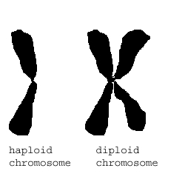
Chromosomes
In somatic diploid cells, homologous chromosomes pair, one of the pair having come from the maternal parent, one from the paternal parent
During reproduction, haploid gametes are formed
This represents the mechanism by which genes are transmitted from parents to progeny.

Slide 11
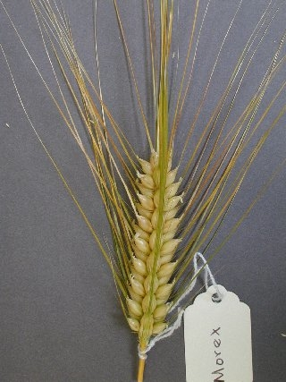
Inheritance of Simple Traits: Hooded x Awned Barley
X

Slide 12
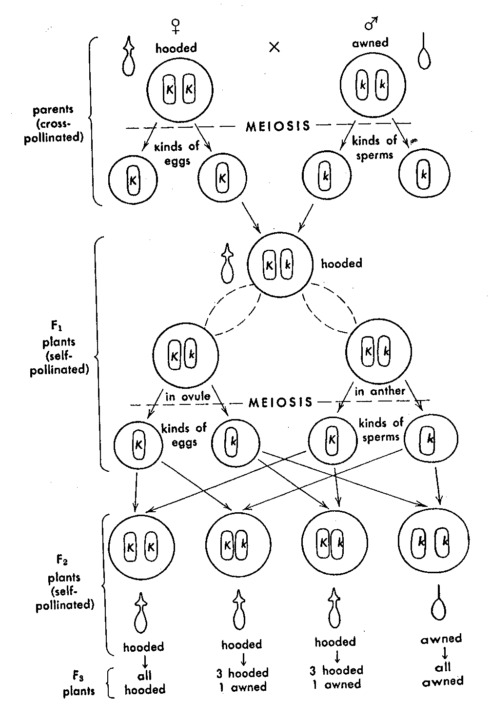
Parental, F₁ and F₂ Generations
In the cross of a Hooded
X Awned Barley

Slide 13
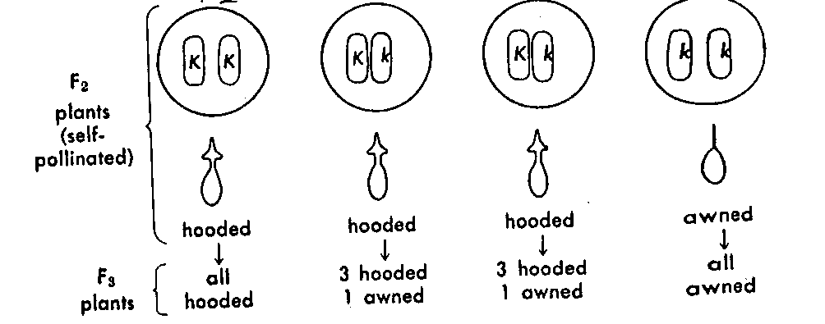
Progeny Test

Slide 14
Progeny Test
The progeny test tells the breeder the genotype of the plant of interest. Is the variation heritable? If so, is it true breeding (homozygous), or will more selection and purification be required?
The progeny of the plant tells the breeder more about the plant than the plant itself.

Slide 15
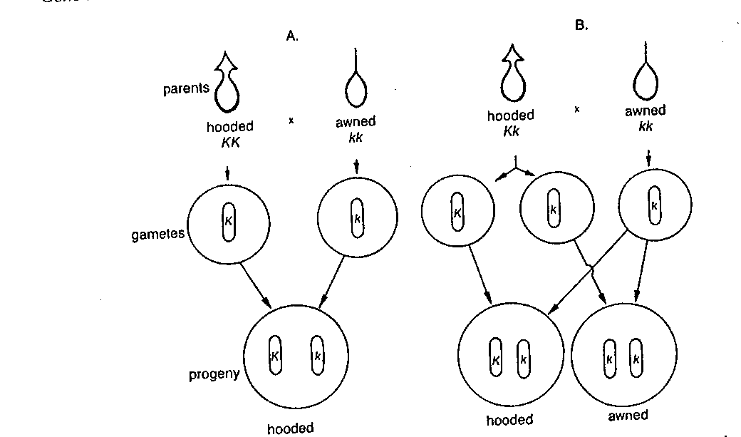
Testcross-another type of progeny test

Slide 16
More than one Trait
Oderbrucker barley: rough awns
Lion barley: smooth awns, black hulls
Goal: a smooth awned barley with white hulls

Slide 17
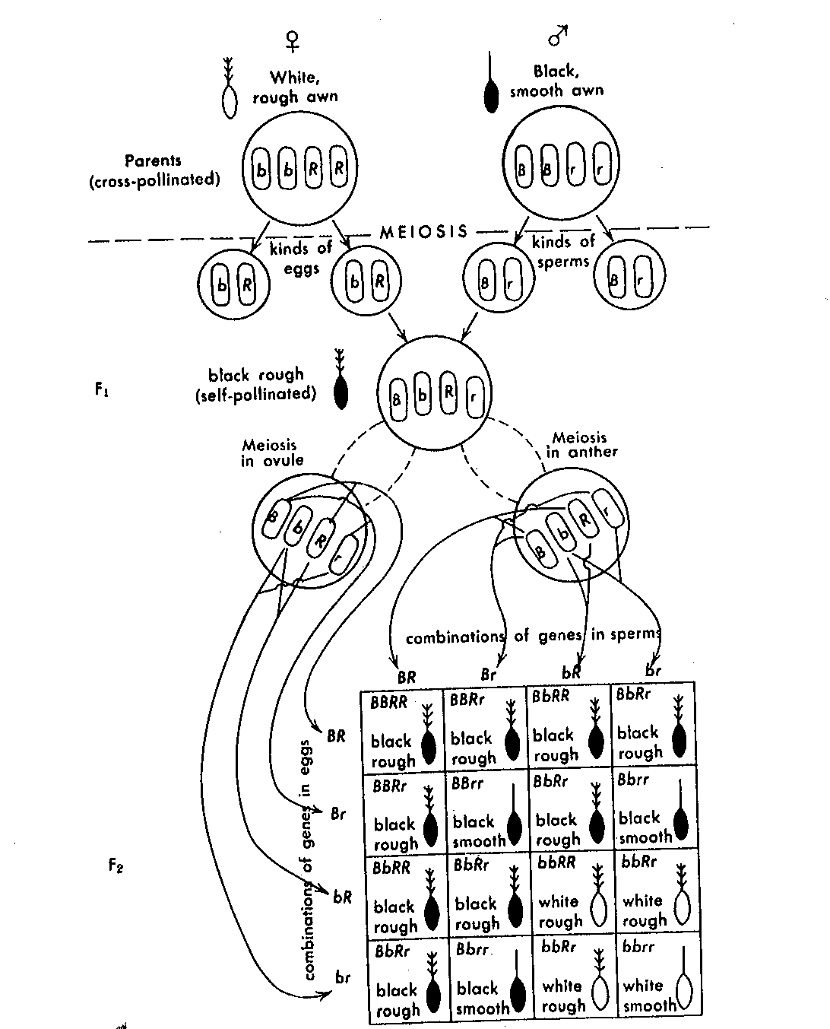
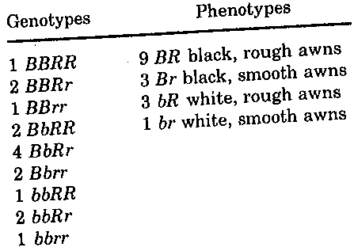

Slide 18
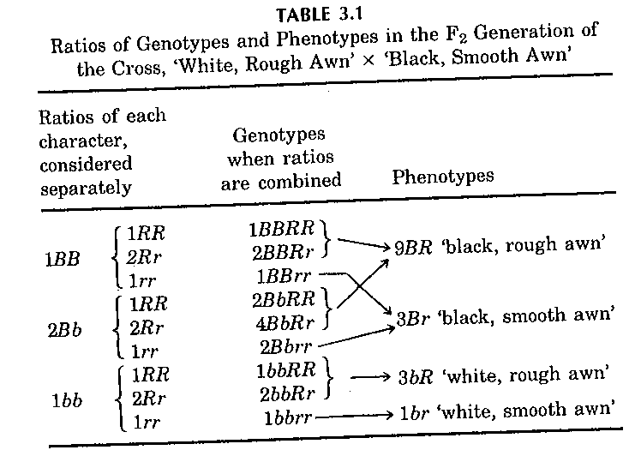

Slide 19
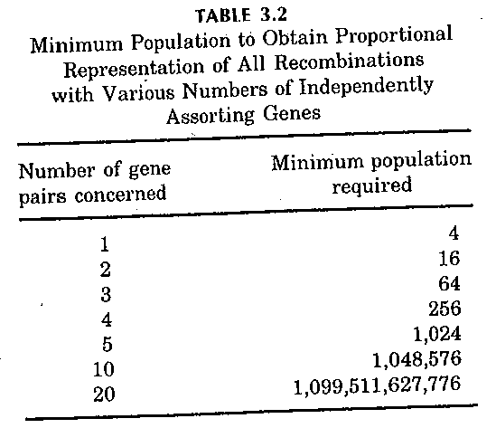

Slide 20
Linkage
Genes on the same chromosome may not sort independently from one another
This requires a larger population size to recover the recombinant types

Slide 21
Crossing Over

Slide 22
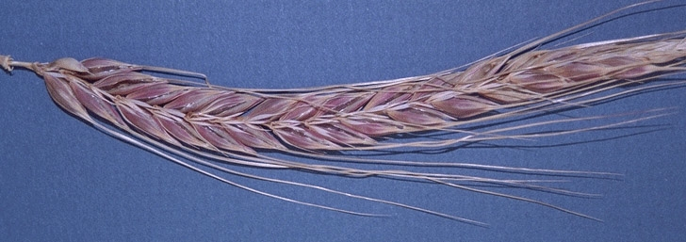
2 row, purple lemma x 6 row, white lemma barley
X

Slide 23
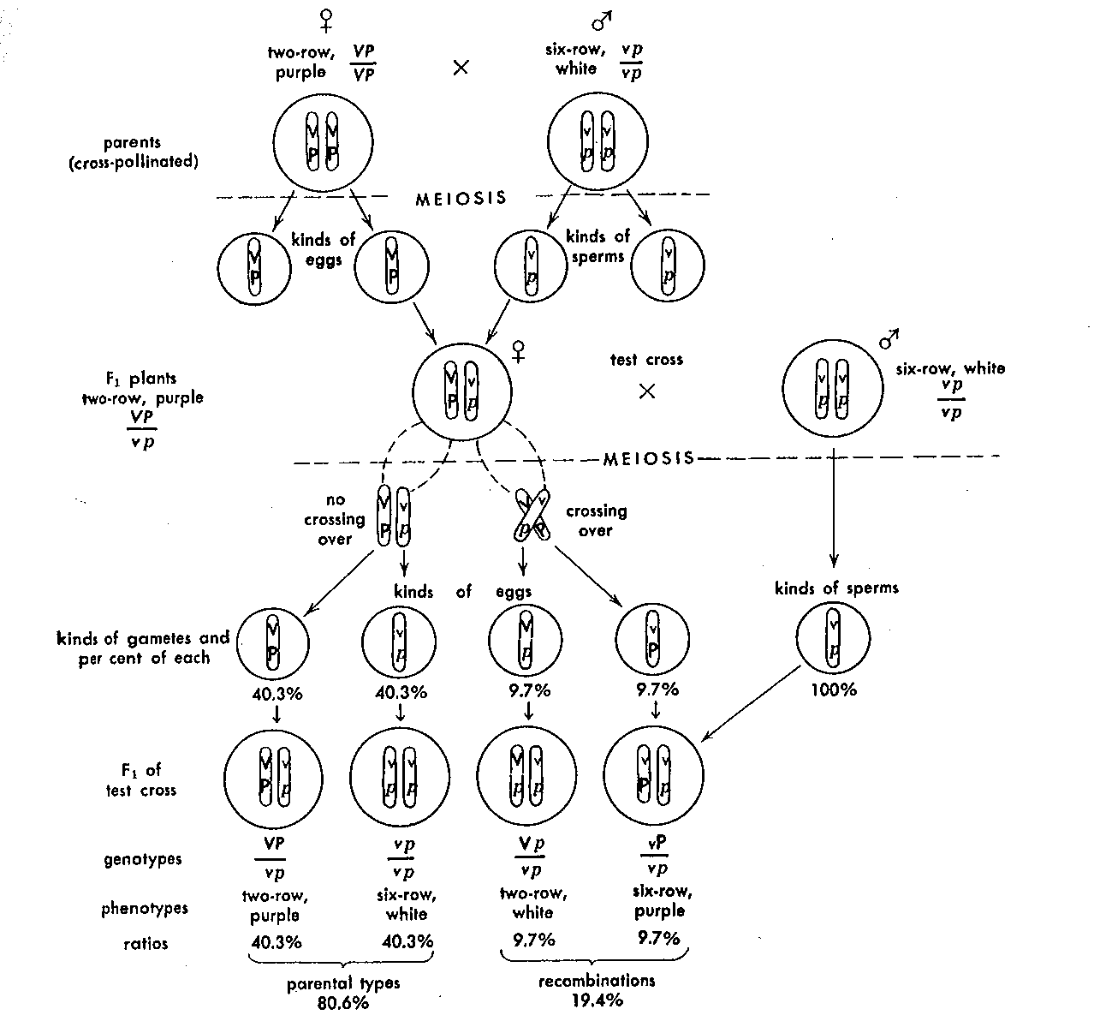

Slide 24
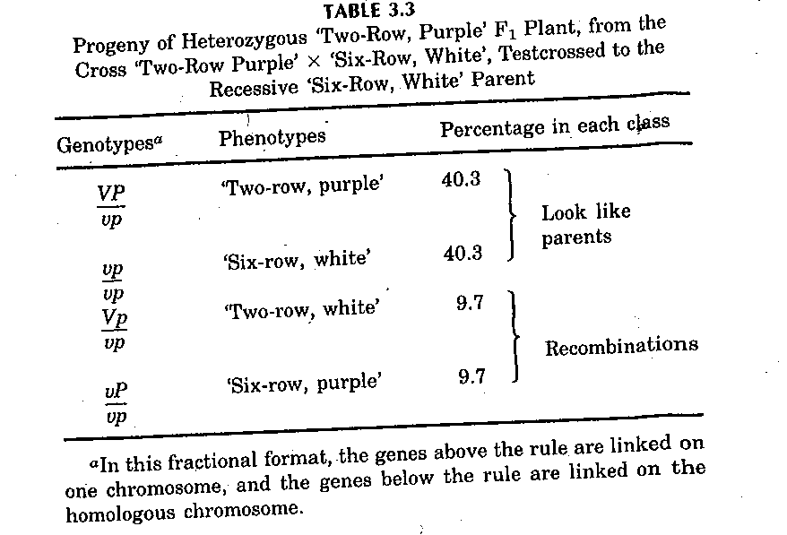

Slide 25
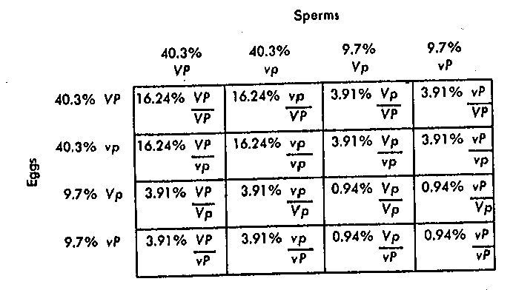
Punnett Square Shows F2 Genotypes and Their Frequencies

Slide 26
F2 Phenotypes

Slide 27
Observed vs Expected
Genotype | Observed No. (O) | Expected No. (E) | (O-E)²/E
A_B_ | 284 | 214.3 | 22.67
A_bb | 21 | 71.4 | 35.58
aaB_ | 21 | 71.4 | 35.58
aabb | 5 | 23.8 | 40.9
 | 381 | 380.9 | 134.72

Slide 28
Chi Square Test
Null hypothesis: genes are independent
Degrees of freedom (df) = no. classes-1=3
Chi square statistic Χ²_{0.05} = 7.82
Since our calculated Χ² = 134.72 we reject the null hypothesis

Slide 29
Trihybrid Testcross
Recombinant events | Gametes | Testcross progeny
No crossover | ABC | 401
 | abc | 409
Crossover in AB region | Abc | 32
 | aBC | 28
Crossover in BC region | Abc | 6.1
 | abC | 64
Crossover in both | AbC | 2
 | aBc | 3
 |  | 1000

Slide 30
Recombination Frequency
Between A and B:
Parental types (ABC, ABc, abC,abc)=(401+61)+(64+409)=935=93.5%
Recombinant types (AbC,Abc,aBC,aBc)=(2+32)+(28+3)=6.5%
Do on your own: calculate recombination between B and C

